Slide 1



Text to SQL Query Generation Using LangChain Framework and LLMs
Course: Data Engineering Capstone (CSCI 6991)
Team Members:
Muqeem Ahmed, Mohammad Haram Kafil, Syed Abbas Husainy
Faculty Advisor: Dr. Feng George Yu

Slide 2
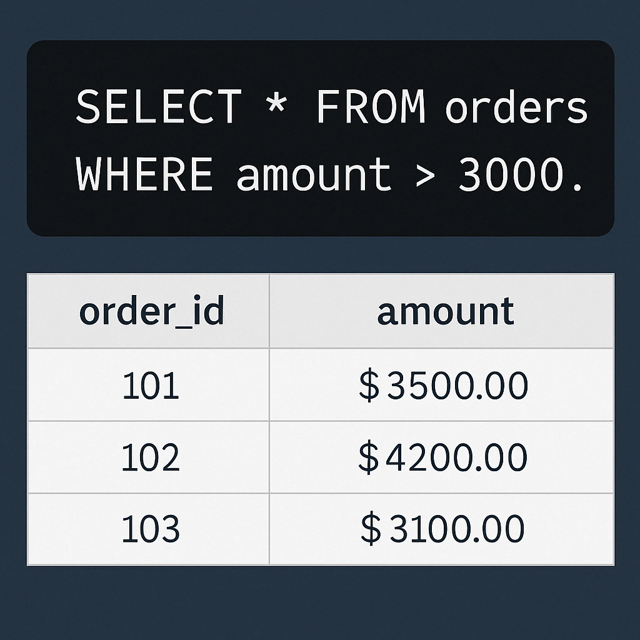
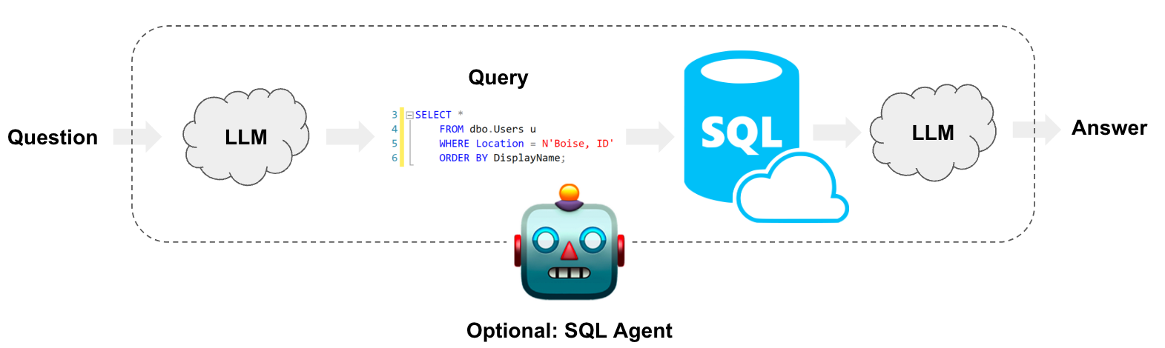

Project Overview
Objective: Automate the conversion of natural language questions into SQL queries.
Significance: Streamlines database interactions, makes data accessible for non-technical users.

Slide 3
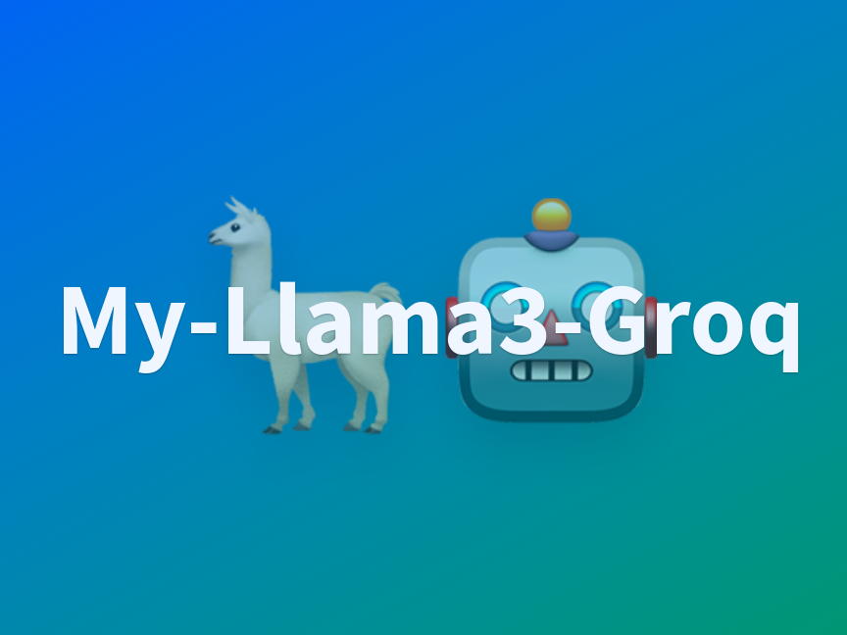
Technologies Used
LangChain Framework
Large Language Models (LLMs)
Llama-4 Maverick 17B (Groq)
Llama-3 Nemotron Super 49B (OpenRouter)
SQLite Database (tpch120k)
Python Environment & Jupyter Notebook

Slide 4


Methodology
Database Connection: Establish a connection using LangChain’s SQLDatabase.
LLM Integration: Leverage LLMs for generating syntactically correct SQL queries.
Few-Shot Prompting: Enhance accuracy through predefined SQL examples.
Execution & Result Formatting: Query database and provide human-readable answers.

Slide 5
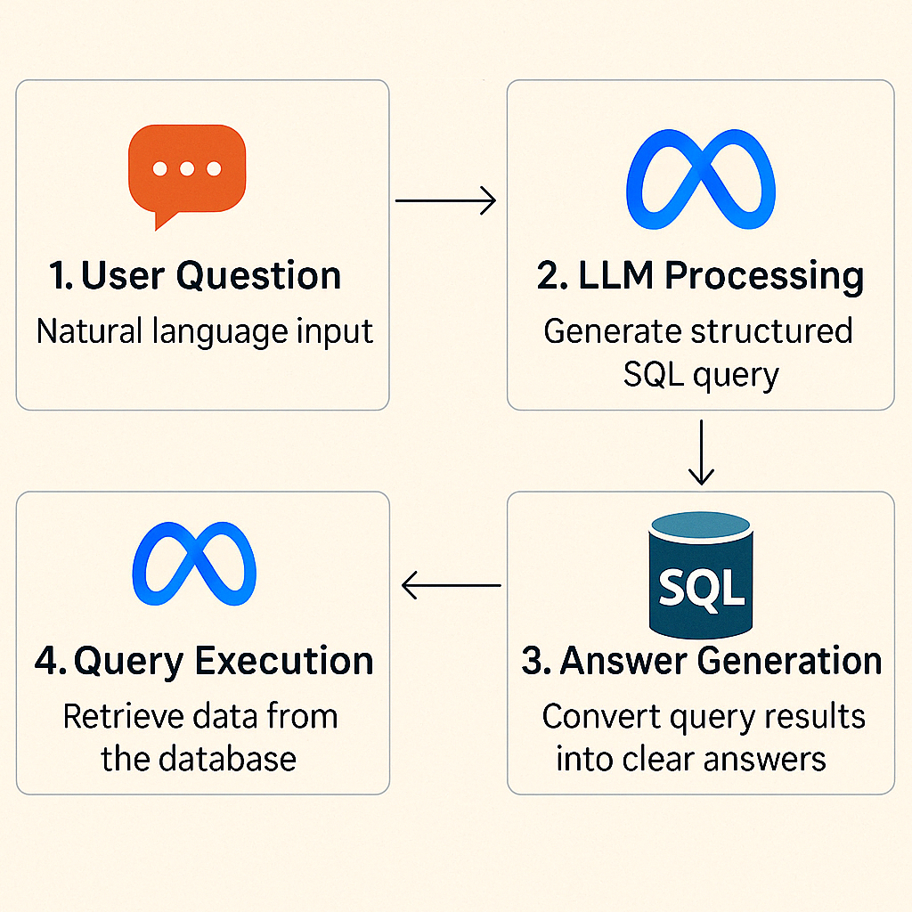
Project Workflow
User Question: Natural language input
LLM Processing: Generate structured SQL query
Query Execution: Retrieve data from the database
Answer Generation: Convert query results into clear answers

Slide 6
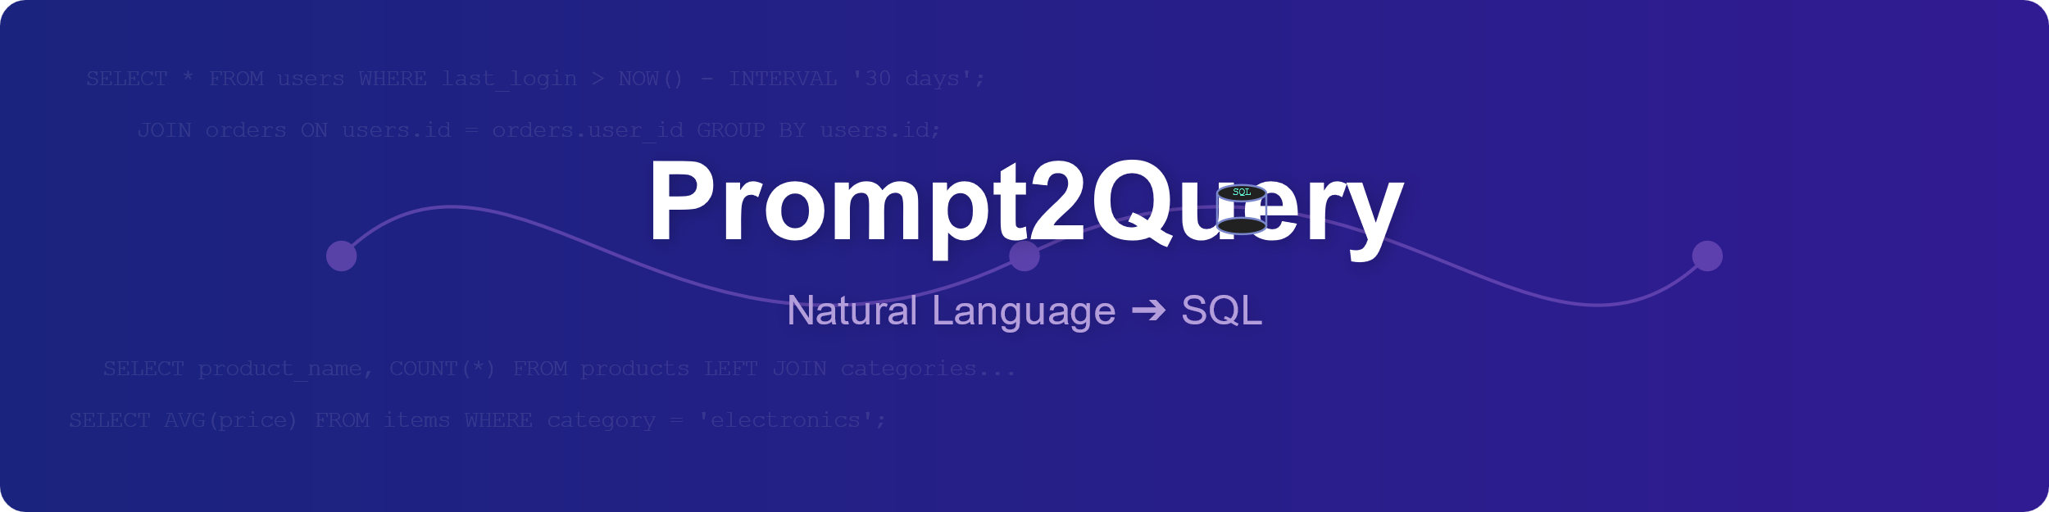
Key Features
Automatic Query Generation: Converts plain English into valid SQL.
Structured Output: Ensures SQL queries are correct and optimized.
Real-time Interaction: Immediate response and easy database interaction

Slide 7

Challenges & Solutions
Accuracy of Queries: Resolved by employing few-shot prompting techniques.
Integration Complexity: Managed by utilizing LangChain’s intuitive APIs.
LLM Performance Variability: Addressed by careful model selection (Llama-4 and Llama-3).

Slide 8
Results & Demonstration
Successfully executed multiple queries (e.g., fetching orders costing over $3000).
Demonstrated high accuracy and responsiveness of system.
Improved accessibility of database information.

Slide 9

Team Contributions
Muqeem Ahmed: Project lead, implemented LangChain and LLM integration.
Haram Kafil: Managed database setup, query execution, and result processing.
Syed Abbas Husainy: Handled prompt engineering and optimization for accurate SQL generation.

Slide 10

Future Enhancements
Expand Database Compatibility: Integration with more database systems (e.g., MySQL, PostgreSQL).
Optimize Query Performance: Further refinement in query accuracy and speed.
User Interface Development: Create a user-friendly interface for broader user engagement.

Slide 11

Conclusion
Effective implementation of Text to SQL using advanced AI techniques.
Demonstrates potential to significantly enhance database interaction.
Opens avenues for future innovation in AI-driven data accessibility.

Slide 12
Q&A
Questions?

Slide 13

Thank You

